Slide 1
Post-Market surveillance of Illumina products
Ivan Charkin, Jeff Leath, Alec Neff
MSDS 7330 project

Slide 2
Summary
The goal of this project is to collect the post-market data on the performance of products made by Illumina and organize the information into a database
The data are obtained from Twitter by scraping with a custom R script
The data are organized using a schema created using MySQL

Slide 3
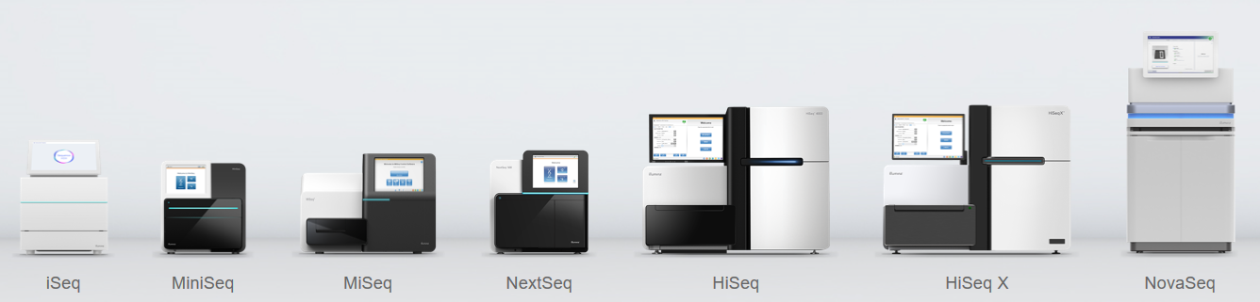
Illumina
Illumina is a leading company in the DNA sequencing market
It produces multiple platforms of DNA sequencers for various applications and consumables used for sequencing runs
The products are used for both research and medical diagnostics purposes (e.g. in-vitro diagnostics, cancer research)
www.illumina.com

Slide 4
Illumina
Illumina is a leading company in the DNA sequencing market
It produces multiple platforms of DNA sequencers for various applications and consumables used for sequencing runs
The products are used for both research and medical diagnostics purposes (e.g. in-vitro diagnostics, cancer research)
www.illumina.com

Slide 5

Post-market surveillance
For on-market products it is generally a good practice to proactively seek customer feedback on the product performance instead of relying on complaints only
For medical devices proactive collection of data is required per Federal Regulations as part of post-market surveillance to identify any problems with the product
The data are supposed to be collected during the whole time the product is on the market

Slide 6
Post-market surveillance
For on-market products it is generally a good practice to proactively seek customer feedback on the product performance instead of relying on complaints only
For medical devices proactive collection of data is required per Federal Regulations as part of post-market surveillance to identify any problems with the product
The data are supposed to be collected during the whole time the product is on the market

Slide 7
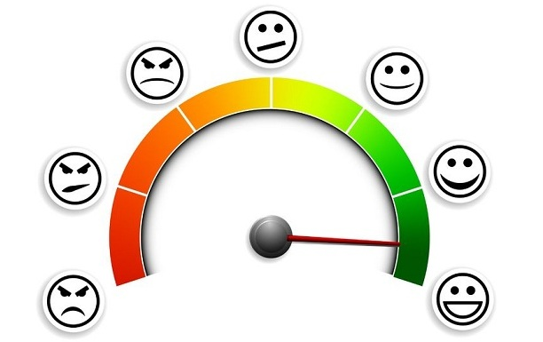
Examples of post-market data sources
Customer complaints – mostly reactive
Customer polls and questionnaires
Parts replacement data
Returns data
Clinical studies
Social media discussions and – focus of this project

Slide 8
Examples of post-market data sources
Customer complaints – mostly reactive
Customer polls and questionnaires
Parts replacement data
Returns data
Clinical studies
Social media discussions and – focus of this project

Slide 9

Data scraping
There are several specialized websites hosting discussion forums for specific applications of Illumina products, but the data access is limited
We chose Twitter since there are already scraping libraries available
The following keywords were used in preliminary runs:
Illumina
MiSeq
MiniSeq
NextSeq
NovaSeq
iSeq
HiSeq

Slide 10
Data scraping
There are several specialized websites hosting discussion forums for specific applications of Illumina products, but the data access is limited
We chose Twitter since there are already scraping libraries available
The following keywords were used in preliminary runs:
Illumina
MiSeq
MiniSeq
NextSeq
NovaSeq
iSeq
HiSeq

Slide 11
Data scraping cont.
Library("twitteR") is used to scrape data from Twitter
Results are imported into a CSV file

Slide 12
Database plan
The following attributes will need to be extracted and recorded in the database:
Product
Date
Author of the post
Text
Other relevant attributes…
Natural language processing will be needed to extract some of the attributes

Slide 13
Database plan
The following attributes will need to be extracted and recorded in the database:
Product
Date
Author of the post
Text
Other relevant attributes…
Natural language processing will be needed to extract some of the attributes

Slide 14
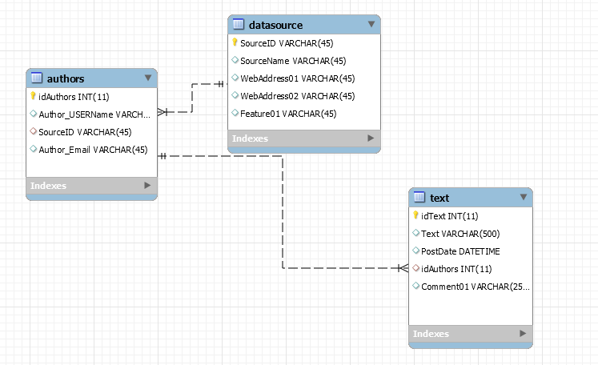
Very preliminary Schema based on available data
This schema will be expanded and optimized – bulk of the project

Slide 15
Very preliminary Schema based on available data
This schema will be expanded and optimized – bulk of the project

Slide 16
Natural language processing
To convert the text from scraped customer comments to the database attributes we plan to use R
Package library(tm) can be used for simple analysis
Remove punctuation
Convert to lower case
Ability to remove the numbers – may not use since numbers can relevant to the discussion

Slide 17
Natural language processing
To convert the text from scraped customer comments to the database attributes we plan to use R
Package library(tm) can be used for simple analysis
Remove punctuation
Convert to lower case
Ability to remove the numbers – may not use since numbers can relevant to the discussion

Slide 18
More details on NLP
Package tm is also capable of more advanced functions such as to
filter documents for certain criteria
perform full text search.
The package also supports the export from document collections to term-document matrices
We may use another package based on feedback for this presentation

Slide 19
More details on NLP
Package tm is also capable of more advanced functions such as to
filter documents for certain criteria
perform full text search.
The package also supports the export from document collections to term-document matrices
We may use another package based on feedback for this presentation

Slide 20
Next steps
Collect more Twitter data
Choose NLP package
Design Database Schema based on the NLP package capabilities
Perform basic analysis using the database output

Slide 21
Next Steps
Collect more Twitter data
Choose NLP package
Design Database Schema based on the NLP package capabilities
Perform basic analysis using the database output
Questions?

